Slide 1
Spring Boot

Slide 2
Introduction to Spring Boot
Spring Applications
Spring Boot to the Rescue
Why Spring Boot?
Spring Boot Features
Notes:
This chapter introduces the Spring Boot technology and gives you a taste of what it is and what you can do with it. You will learn about all its features and the associated how-tos during the course.

Slide 3
Introduction to Spring Boot
Spring Boot is the Spring Framework. You can view Spring Boot as a new way to create Spring applications with ease.
Spring Boot simplifies the way you develop, because it makes it easy to create production-ready Spring-based applications that you can just run .
Spring Boot is an “opinionated” technology in that it will help you follow the best practices for creating robust, extensible, and scalable Spring applications.
http://projects.spring.io/spring-boot/

Slide 4
Introduction to Spring Boot
Primary goals:
• Provide a radically faster and widely accessible getting started experience for all Spring development.
• Be opinionated out of the box, but get out of the way quickly as requirements start to diverge from the defaults.
• Provide a range of non-functional features that are common to large classes of projects (e.g. embedded servers, security, metrics, health checks, externalized configuration).
• Absolutely no code generation and no requirement for XML configuration.

Slide 5
Spring Applications
Create a folder structure that contains your WAR (Web ARchive):
It must contain a WEB-INF folder with lib and classes subfolders that contain the
third-party libraries and your web application classes, respectively.
Some JSP (if needed), HTML, CSS, images, and JavaScript (if needed) files.
A file named web.xml that will contain the Spring org.springframework.web.
servlet.DispatcherServlet class.
Your Spring beans in the form <servlet-name>-servlet.xml (of course, you can override this and add the complete location and name of your Spring beans).
Notes:
If you are a Spring developer, you already know that in order to create a simple Spring web application, you must follow certain rules of the J2EE stack and some of the Spring Framework. Those rules include the following:

Slide 6
Spring Applications
Use a utility to package your WAR file. You can use the jar tool, but most people are more used to running Apache Maven or Gradle, or Apache Ant to compile, test, and create the WAR file.
Use an application server or container to run your WAR file, such as Tomcat, Jetty, Jboss, or WebSphere.
Notes:
Even though it’s only a few steps, the reality is a more painful when you have a lot of resources and classes and a bunch of Spring beans that you need to include, wire up, and use. I am not criticizing the way Spring web applications are developed, but I think it is more about what tool you use to help you
avoid this particular hassle. Tools range from an IDE such as the STS tool ( https://spring.io/tools ) that helps you include the correct Spring XML schemas for declaring your beans, to external tools like YEOMAN ( http://yeoman.io/ ), which helps you create the structure and avoid the boilerplate to set everything up.
I am talking about a simple Spring web application, but what happens when you need to include some persistence, or messaging, or perhaps you need to include security? Then you need an easy way to manage your dependencies. Of course, the easiest way is to download each dependency, but this can become a nightmare, at which point you will start looking for tools like Apache Maven or Gradle (a Groovy DSL for compile, build, and deploy use) to help you with these dependency management tasks.

Slide 7
Spring Boot to the rescue
import org.springframework.boot.SpringApplication;
import org.springframework.boot.autoconfigure.SpringBootApplication;
@RestController
@SpringBootApplication
public class SimpleWebApp {
public static void main(String[] args) {
SpringApplication.run(SimpleWebApp.class, args);
}
@RequestMapping("/")
public String greetings(){
return "<h1> Spring Boot Rocks in Java!</h1>";
}
}
Notes:
Instead of reading more about Spring Boot and how easy it is to use, take a look at the simplest Spring web application possible.
Listing shows you the entry point for a Spring Boot application in Java. It’s using a @SpringBootApplication annotation and the SpringApplication singleton class in the main method that will execute the application.
The run method call accepts two parameters (the class that actually contains the annotated @SpringBootApplication annotation and the application’s arguments.
You use the @RestController and the @RequestMapping annotations to tell Spring to use the class as a web controller and to use the method greetings as an entry point for an HTTP request.

Slide 8
Spring Boot to the rescue
mvn spring-boot:run
Open a browser and point to the URL http://localhost:8080/
You should see the message: Spring Boot Rocks in Java!.
Notes:
You can run this example by using the Spring Boot CLI.

Slide 9
Why Spring Boot?
Spring Boot has many features that make it suitable for:
• Cloud Native Applications that follow the 12 factor patterns
• Productivity increases by reducing time of development and deployment
• Enterprise-production-ready Spring applications
• Non-functional requirements, such as the Spring Boot Actuator (a module that brings metrics, health checks, and management easily) and embedded containers for running web applications (such as Tomcat, Undertow, Jetty, etc.)
Notes:
developed by the Netflix engineering team at http://12factor.net/

Slide 10
Spring Boot Features
The SpringApplication class. In a Java Spring Boot application, the main method executes this singleton class. This particular class provides a convenient way to initiate a Spring application.
Spring Boot allows you to create applications without requiring any XML configuration. Spring Boot doesn’t generate code.
Spring Boot is an “opinionated” technology.
Spring Boot allows you to execute code after the application has started.
Spring Boot allows you to externalize configurations by using an application.properties or application.yml file.
Notes:
Opinionated: which means that Spring Boot will attempt to create the right type of application, either a web application (by embedding a Tomcat or Jetty container) or a single application.
The only thing you need to do is implement the CommandLineRunner interface and provide the implementation of the run(String ...args) method.

Slide 11
Spring Boot Features
Spring Boot allows you to have profiles that will help your application run in different environments.
Spring Boot provides a simple way to configure and manage your dependencies by using starter poms
Spring Boot provides out-of-the-box non-functional requirements by using the Spring Boot Actuator
Spring Boot provides @Enable<feature> annotations that help you to include, configure, and use technologies like databases (SQL and NoSQL), caching, scheduling, messaging, Spring integration, Spring cloud, and more.

Slide 12
Spring Boot with Maven
<!-- Spring Boot Parent Dependencies-->
<parent>
<groupId>org.springframework.boot</groupId>
<artifactId>spring-boot-starter-parent</artifactId>
<version>1.5.3.RELEASE</version>
</parent>
Notes:
The following sections explain what you need for every project in Spring Boot. You must see these as requirements if you want to use Maven or Gradle to develop Spring Boot apps.
If you take a closer look, there is a <parent/> tag section where you need to include the spring-boot-starter-parent artifact. This particular dependency contains all you need to run your app.
It contains all the descriptions of dependencies that a Spring Boot application needs, like all the dependencies of the Spring Framework ( spring-core ), Spring Test ( spring-test ), and more.
The advantage of using the spring-boot-starter-parent POM file is that developers need not worry about finding the right compatible versions of different libraries such as Spring, Jersey, JUnit, Logback, Hibernate, Jackson, and so on.
The starter POM file itself does not add JAR dependencies to the project. Instead, it will only add library versions. Subsequently, when dependencies are added to the POM file, they refer to the library versions from this POM file.

Slide 13
Spring Boot with Maven
<!-- Add dependencies: starter poms -->
Starters are a set of convenient dependency descriptors that you can include in your application.
<dependencies>
<dependency>
<groupId>org.springframework.boot</groupId>
<artifactId>spring-boot-starter-web</artifactId>
</dependency>
...
</dependencies>
If you want to use a starter pom, you have to add the following syntax.
<dependency>
<groupId>org.springframework.boot</groupId>
<artifactId>spring-boot-starter-[TECHNOLOGY]</artifactId>
</dependency>
Notes:
Another section is the starter poms , where you declare the dependencies of the actual Spring Boot feature you want to use. The starter poms will bring all the dependencies that you need for our application, which is why you need to include just one starter pom. For example, if you are creating a web application, the only dependency you need is the spring-boot-starter-web artefact.
Application starters, Production starters, Technical starters
This dependency will include all the spring-web , spring-webmvc , embedded Tomcat server, and other libraries related to the web application.
A later section of this presentation explains more about the Spring Boot starter poms. At this point, you simply need to understand that you can include these dependencies in your main pom.xml file.

Slide 14
Spring Boot with Maven
<!-- Spring Boot Plugin for creating JAR/WAR files -->
<build>
<plugins>
<plugin>
<groupId>org.springframework.boot</groupId>
<artifactId>spring-boot-maven-plugin</artifactId>
</plugin>
</plugins>
</build>
Notes:
To create an executable jar we need to add the spring-boot-maven-plugin to our pom.xml. This particular plugin will help you package your application as a JAR or WAR with the command: mvn package. It also has several goals/tasks that you can use, like the one in the previous chapter for running the Spring Boot app: mvn spring-boot:run .
The spring-boot-starter-parent POM includes <executions> configuration to bind the repackage goal.
Since we have used the spring-boot-starter-parent POM we have a useful run goal that we can use to start the application. spring-boot:run

Slide 15
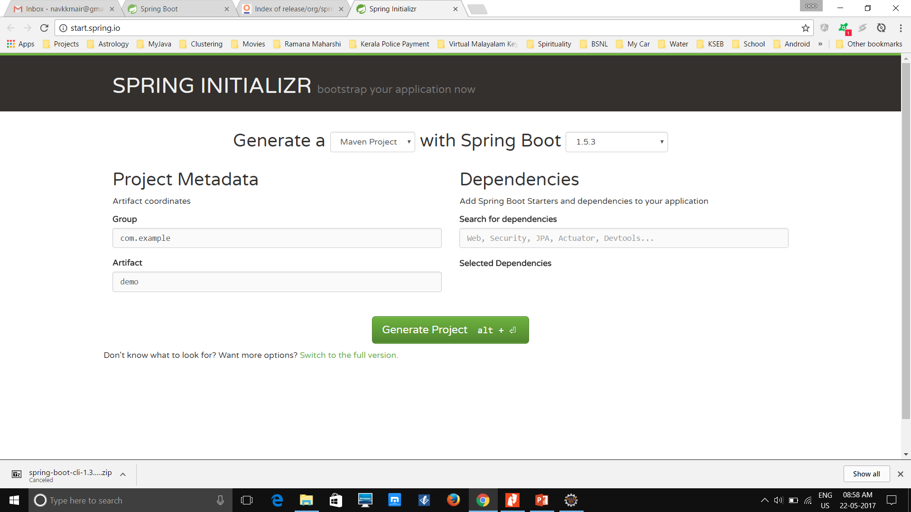
Spring Boot using External tools
Spring Boot Using the Spring Initializr
http://start.spring.io/ (It’s hosted by Pivotal WebServices. )
Notes:
The full version of the Spring Initializr, and if you keep scrolling down, you will find all the dependencies that you can add by clicking on the checkboxes. After you select the features you want
to use, click the Generate Project button to get the ZIP file that contains your project.

Slide 16
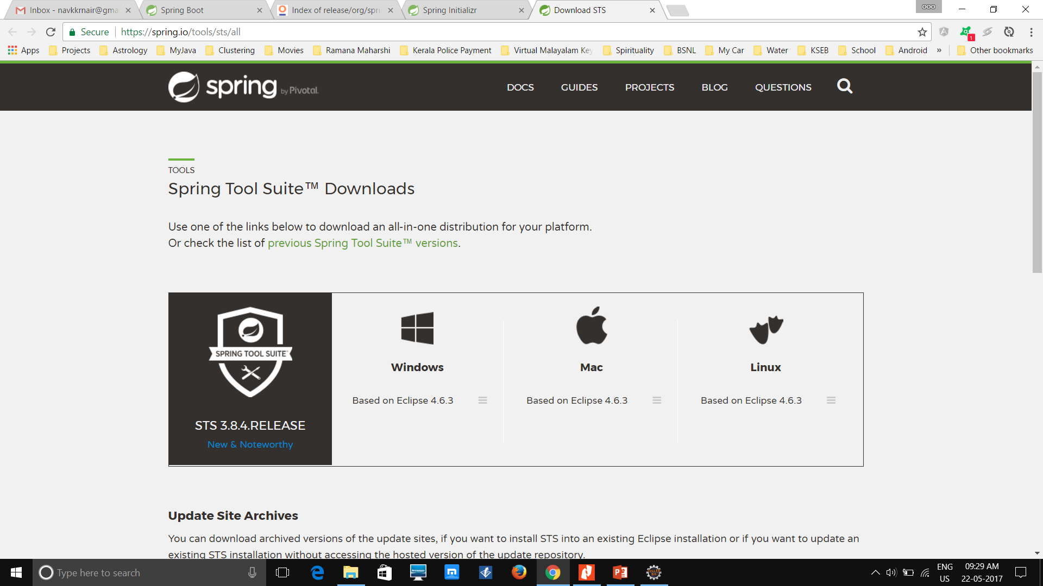
Spring Boot using External tools
Spring Boot Using Spring Tool Suite (STS) @ https://spring.io/tools/sts/all
Notes:
One of the benefits of using the STS is that it comes with Spring Boot support.

Slide 17
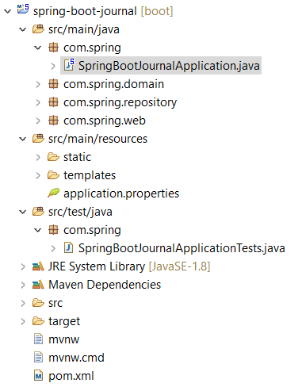
First Spring Boot application
Spring Boot Journal.
Take a look at the project’s file structure. You should have something similar to
Notes:
It’s time to create your first Spring Boot application. The idea of this application is simple—it’s a journal application. You will start with something simple in this chapter, just enough to get to know the Spring Boot internals. During the rest of the presentation, you will modify it so at the end you have a complete and production ready Spring Boot application.
It’s a simple application in which you will have a collection of entries that shows the main ideas over a timeline.
On the next page of the Spring Starter Project wizard, you choose the technologies that Spring Boot Journal will use. In this case, check Web (Web), Template Engines (Thymeleaf, which is a template engine capable of processing and generating HTML, XML, JavaScript, CSS, and text that is suitable for the view layer of web applications, a better approach to the Java Server Pages or
JSPs, because it’s faster and more reliable), Data (JPA), and Database (H2). This example uses the JPA technology with the in-memory H2 database.

Slide 18
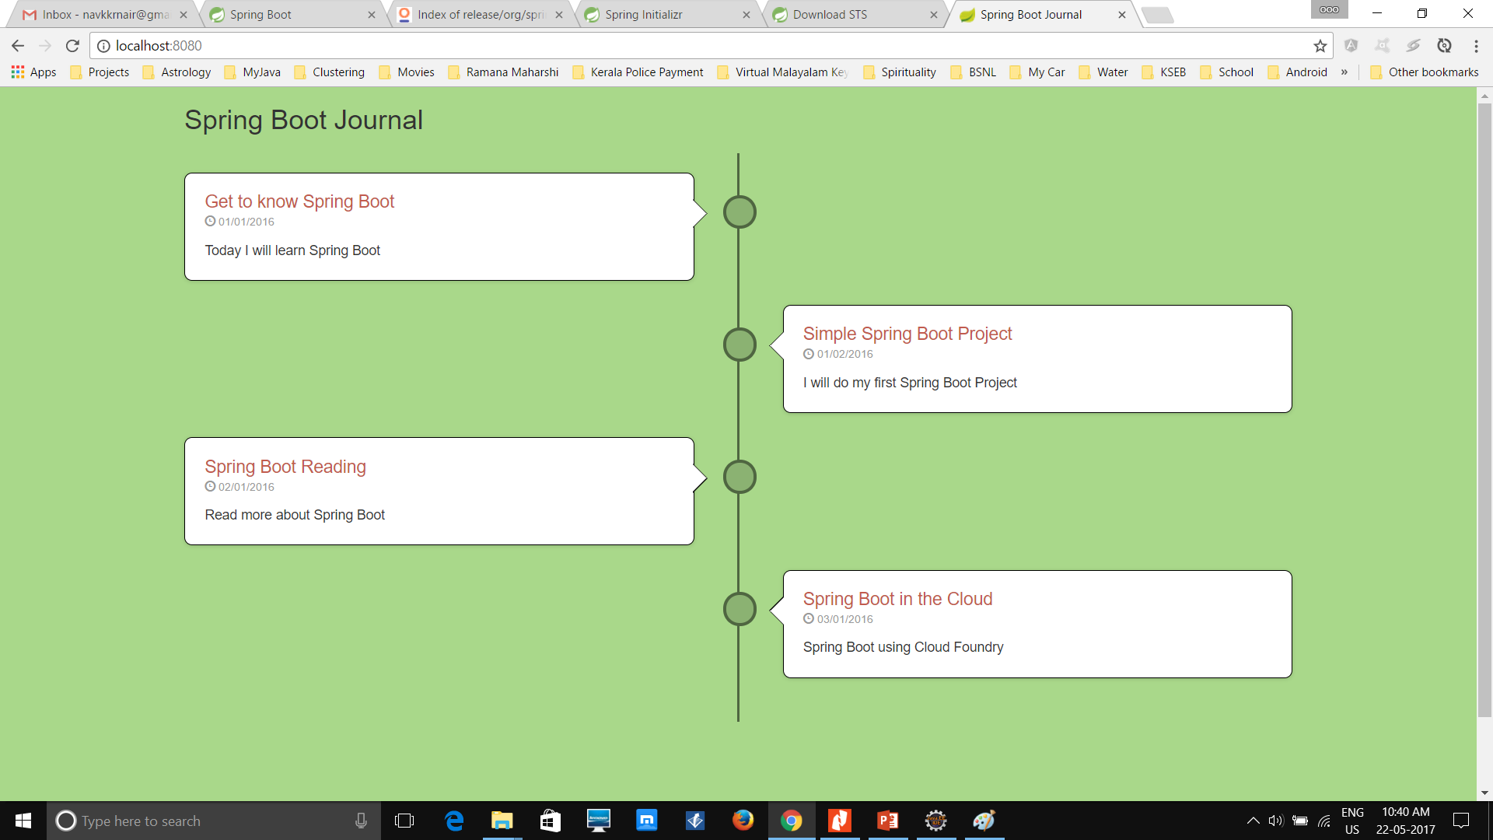
First Spring Boot application
In order to run it, select the SpringBootJournalApplication.java class from the Package Explorer view and right-click on it. Then choose Run As ➤ Spring Boot App. Once it's running you can open a browser andpoint to http://localhost:8080 . You should see something like
Notes:
Figure shows you the result of running the Spring Boot journal application. If you analyze it in more detail, probably what is most time consuming will be the graphic design rather than the code. With only a few lines of code, you have a very cool Spring Boot app.
curl -i -H "Accept: application/json" http://localhost:8080/journal

Slide 19
How Spring Boot works
package org.springframework.boot.autoconfigure;
@Target(ElementType.TYPE)
@Retention(RetentionPolicy.RUNTIME)
@Documented
@Inherited
@SpringBootConfiguration
@EnableAutoConfiguration
@ComponentScan
public @interface SpringBootApplication {
Class<?>[] exclude() default {};
String[] excludeName() default {};
@AliasFor(annotation = ComponentScan.class, attribute = "basePackages")
String[] scanBasePackages() default {};
@AliasFor(annotation = ComponentScan.class, attribute = "basePackageClasses")
Class<?>[] scanBasePackageClasses() default {};
}
Notes:
I think now is time to see how Spring Boot does it; how it works internally to relieve the developer from the headache of a J2EE web application. If you are a Spring or J2EE developer, you saw that you didn’t use a configuration file or XML ( web.xml ), no @Configuration class, or any other Spring Beans definition file. Maybe you are thinking that Spring Boot generated code抑some classes to create all the necessary files to run this application but that’s not the case, Spring Boot never generates code and will never output any source code. Remember that I said that Spring Boot is an opinionated technology, which means that it follows the best practices to create a very robust application with minimum effort.
Let’s see what is really happening when you run the SpringBootJournalApplication app. What is important to see is that this is a composed annotation because it contains the @Configuration , @EnableAutoConfiguration , and @ComponentScan annotations.
Spring Boot uses the @SpringBootApplication and the auto-configuration (based on the @EnableAutoConfiguration annotation ) to try to identify all your components. First it will
inspect your classpath, and because your dependency is a spring-boot-starter-web , it will try to configure the application as a web application. It will also identify that the JournalController class is a web controller because it is marked with the @Controller and because it contains the @RequestMapping annotations. And because the spring-boot-starter-web has the Tomcat server as a dependency, the Spring Boot will use it when you run your application.
Note that you can exclude Tomcat and use another server like Jetty or Undertow.

Slide 20
Auto-Configuration
spring run app.java --debug
...
DEBUG 49009 --- [] autoConfigurationReportLoggingInitializer :
===========================
AUTO-CONFIGURATION REPORT
===========================
Positive matches:
-----------------
//You will see all the conditions that were met to enable a web application. And this is because you have the @RestController annotation.
Negative matches:
-----------------
//You will find all the conditions that failed. For example you will find that the
ActiveMQAutoConfiguration class did not match, because you don't have any reference of the ActiveMQConnectionFactory.

Slide 21
Auto-Configuration
Disabling a Specific Auto-Configuration
import org.springframework.boot.autoconfigure.jms.activemq.ActiveMQAutoConfiguration
@RestController
@EnableAutoConfiguration(exclude={ActiveMQAutoConfiguration.class})
class WebApp{
@RequestMapping("/")
String greetings(){
"Spring Boot Rocks"
}
}
...
Exclusions:
-----------
org.springframework.boot.autoconfigure.jms.activemq.ActiveMQAutoConfiguration
...
Notes:
If you run this again with the following command: spring run app.groovy –debug, we can see an exclusions section.
You might wonder why you would want to exclude a configuration. Well, sometimes you will have dependencies that work in two different types of applications—web and non-web for example—and you want to use the jackson-core library that handles JSON objects to create a non-web app. This library can work in web or non-web apps, but the auto-configuration will guess that, based on this dependency, your application is a web app. In that case, you can exclude the web auto-configuration from happening. This is one example of many where you might use the auto-configuration exclusion.

Slide 22
@EnableAutoConfiguration
Spring Framework and some of its modules—like Spring Core, Spring Data, Spring AMQP, and Spring Integration provide @Enable<Technology> annotations
Spring Boot takes advantage of these annotations.
@EnableAutoConfiguration annotation.
...
// More declarations here ...
...
@Import ( EnableAutoConfigurationImportSelector.class )
public @interface EnableAutoConfiguration {
Class<?>[] exclude() default {};
String[] excludeName() default {};
}
Notes:
You will find that the Spring Framework and some of its modules—like Spring Core, Spring Data, Spring AMQP, and Spring Integration—provide @Enable<Technology> annotations. For example, @EnableTransactionManagement , @EnableRabbit , and @EnableIntegration are part of the modules mentioned. Within Spring applications, you can use these annotations to follow the pattern “convention over configuration,” thus making your apps even easier to develop and maintain without worrying too much about configuration.

Slide 23
@EnableAutoConfiguration
protected List<String> getCandidateConfigurations(AnnotationMetadata metadata,
AnnotationAttributes attributes) {
return SpringFactoriesLoader.loadFactoryNames(
getSpringFactoriesLoaderFactoryClass(), getBeanClassLoader());
}
...
The SpringFactoriesLoader.loadFactories will look for the META-INF/spring.factories defined in spring-boot-autoconfigure JAR.
Notes:
The EnableAutoConfigurationImportSelector class has a several methods, but one of the most important for the auto-configuration to happen is the getCandidateConfiguration method.
Listing shows you a snippet of the EnableAutoConfigurationImportSelector class, where the getCandidateConfigurations method returns SpringFactoriesLoader.loadFactoryNames . The
SpringFactoriesLoader.loadFactories will look for the META-INF/spring.factories defined in the spring-boot-autoconfigure JAR.
As you can see, it’s very short class, but it will configure a cloud application if it finds the spring-cloud classes. But how? It will use the @ConditionalOnClass and @ConditionalOnMissingBean annotations to decide if the application is a cloud app. Don’t worry too much about this, because you are going to use these annotations when you create your own auto-configuration class in the last chapter of the book.

Slide 24
Deploying Spring Boot
SSL
Creating Executable and Deployable WARs
Notes:
keytool -genkey -alias tomcat -keyalg RSA -keystore src/main/resources/keystore.jks
<dependency>
<groupId>org.springframework.boot</groupId>
<artifactId>spring-boot-starter-tomcat</artifactId>
<scope>provided</scope>
</dependency>
This means that, when you package your application, all the libraries will now be placed in the WEB-INF/lib and the WEB-INF/lib-provided for the Tomcat libraries within the 擢at JAR媒.
This will make your application executable as standalone app and container-ready. There is a reason why in a WAR the tomcat libraries are placed in the WEB-INF-lib-provided directory羊emember that everything that you add in the WEB-INF/lib will be taken by the application container, so if you leave the Tomcat JAR in this directory ( WEB-INF/lib ), the application container will fail because of duplicate JARs. That’s why Spring Boot creates WEB-INF/lib-provided so it can run outside and inside of a container.

Slide 25
Spring Boot features
Custom Banner
SpringApplication app = new SpringApplication(SpringBootSimpleApplication.class);
app.setBanner(new Banner()
{
@Override
public void printBanner(Environment environment, Class<?> sourceClass, PrintStream out)
{
out.print("\n\n\tThis is my own banner!\n\n".toUpperCase());
}
});
Notes:
See code. Simple-spring-boot
You can have a more advanced configuration using the SpringApplication class, because you can create an instance out of it and do a lot more.
-Dbanner.location=classpath:/META-INF/banner.txt
spring.main.banner-mode=off
app.setBannerMode(Mode.OFF);

Slide 26
Spring Boot features
SpringApplicationBuilder
1. If you need to build an ApplicationContext hierarchy (multiple contexts with a parent/ child relationship),
2. If you just prefer using a ‘fluent’ builder API.
Example 1: new SpringApplicationBuilder()
.bannerMode(Banner.Mode.OFF)
.sources(SimpleSpringBootApplication.class)
.run(args);
Example 2: new SpringApplicationBuilder()
.sources(Parent.class)
.child(Application.class)
.bannerMode(Banner.Mode.OFF)
.run(args);
Notes:
The SpringApplicationBuilder allows you to chain together multiple method calls, and includes parent and child methods that allow you to create a hierarchy.
Example 2: All of the contexts are configured from the same locations. This means that the default configuration file will be used to configure all of them, which is why it is important to make sure that it contains no configurations that can’t be shared among contexts. We need to ensure that two child contexts are using different ports

Slide 27
Spring Boot features
ApplicationRunner and CommandLineRunner
CommandLineRunner exposes the public void run(String... args) method
ApplicationRunner exposes the public void run(ApplicationArguments args) method.
These are practically the same. It’s not necessary to implement both at the same time;
If you want to have more control over the arguments, implement the ApplicationRunner interface.
InitializingBean: This particular class is always called when the Spring engine is
creating the instance to initialize it.
Notes:
Spring Boot allows you to execute code before your application starts. Spring Boot has the ApplicationRunner and the CommandLineRunner interfaces that expose the run methods.
java -jar target/spring-boot-simple-0.0.1-SNAPSHOT.jar --enable arg1 arg2

Slide 28
Application Configuration
Spring Boot has different options for saving your application configuration:
• application.properties , which should be located in the root classpath of your application
• YAML notation file named application.yml also needs to be located in the root classpath
• environment variables. This is becoming the default practices for cloud scenarios.
• command-line arguments.
Notes:
Developers know that they are never going to get rid of some application configuration. They will always be looking where they can persist URLs, IPs, credentials, and database information, for example. Basically any data that they normally use quite often in their applications. They know as a best practice that they need to avoid to hardcode this kind of configuration information. That’s why they need to externalize it so it can be secure and easy to use and deploy.

Slide 29
Application Configuration
Complete list of the common application properties :
https://docs.spring.io/spring-boot/docs/current/reference/html/common-application-properties.html
data.server=localhost:8080
@Value("${data.server}")
private String server;
One of the best features from Spring (and of course from Spring Boot as well) is that you can access the properties values by using the @Value annotation
Notes:
Remember that Spring Boot is an opinionated technology, so most of its application configuration is based on a common application.properties or application.yml file. If none is specified, it already has those property’s values as defaults.
Spring Boot will register a CommandLinePropertySource with the Spring Environment. This allows to inject single application arguments using the @Value annotation.

Slide 30
Application Configuration
$ java -jar target/myapp.jar --data.server=remoteserver:3030
Changing Location and Name of the properties file
Spring Boot has an order to find the application.properties or YAML file.
• The /config subdirectory located in the current directory
• The current directory
• A classpath /config package
• The classpath root
-Dspring.config.name=mycfg
-Dspring.config.location=file:F:/mycfg.properties
Notes:
Remember that Spring Boot is an opinionated technology, so most of its application configuration is based on a common application.properties or application.yml file. If none is specified, it already has those property’s values as defaults.
If you don’t want to use the application.properties , you can inject the properties via the command line: --data.server=remoteserver:3030
-Dspring.config.name=mycfg
java -jar target/spring-boot-config-0.0.1-SNAPSHOT.jar --spring.config.name=mycfg
-Dspring.config.location=file:app/
spring-boot:run -Dspring.config.name=mycfg -Dspring.config.location=classpath:META-INF/conf/
-Dspring.config.name=mycfg -Dspring.config.location=file:F:/mycfg.properties

Slide 31
Application Configuration
Profile Based
Suppose we have 2 file:
application-qa.properties
application-prod.properties
mvn clean spring-boot:run -Dspring.profiles.active=dev
Active profiles can be specified programmatically using the @ActiveProfiles annotation, which is especially useful when running test cases, as follows:
@ActiveProfiles(“qa")

Slide 32
Application Configuration
Custom Properties Prefix
Spring Boot allows you to write and use your own type-safe custom property prefix for your properties.
@ConfigurationProperties
<dependency>
<groupId>org.springframework.boot</groupId>
<artifactId>spring-boot-configuration-processor</artifactId>
<optional>true</optional>
</dependency>
Notes:
This dependency will create a code insight and it will trigger the editor’s code completion for the properties.

Slide 33
Application Configuration
Startup failures
If your application fails to start, registered FailureAnalyzers get a chance to provide a dedicated error message and a concrete action to fix the problem.
Boot contains a series of analyzers for common startup exceptions such as PortInUseException, NoUniqueBeanDefinitionException, and UnsatisfiedDependencyException.
These can be found in the org.springframework.boot.diagnostics package.
Notes:
Spring Boot provides numerous FailureAnalyzer implementations and you can add your own very easily.

Slide 34
Application Configuration
Application Events
You can attach listeners for some of the ApplicationEvent events:
ApplicationStartedEvent (sent at the start)
ApplicationEnvironmentPreparedEvent (sent when the environment is known)
ApplicationPreparedEvent (sent after the bean definitions)
ApplicationReadyEvent (sent when the application is ready)
ApplicationFailedEvent (sent in case of exception during the startup)
Notes:
Spring Boot provides numerous FailureAnalyzer implementations and you can add your own very easily.

Slide 35
Spring Boot CLI
spring run [options] <files> [--] [args]
spring run WebApp.java
spring test [options] files [--] [args]
spring test MyTest.java
spring grab [options] files [--] [args]
spring grab MyTest.java
spring jar [options] <jar-name> <files>
spring jar app.jar app.groovy
Notes:
The grab command will download all the Spring Groovy scripts and Java dependencies to the ./repository directory. If you check out the current directory, you will see the repository subdirectory created with all the dependencies. The grab command is useful when you want to execute a Spring Boot application that doesn’t have an Internet connection and the libraries are needed. The grab command is also used to prepare your application before you can deploy it to the cloud.

Slide 36
Spring Boot CLI
spring war [options] <war-name> <files>
spring install [options] <coordinates>
spring install org.spockframework:spock-core:1.0-groovy-2.4
spring uninstall [options] <coordinates>
spring init [options] [location]
spring init
Notes:
The install command is very similar to the grab command; the only difference is that you need to specify the library you want to install.
The uninstall command will uninstall the dependencies from the lib directory.
The init command will help you initialize a new project by using the Spring Initializr ( http://start.spring.io/ ).

Slide 37
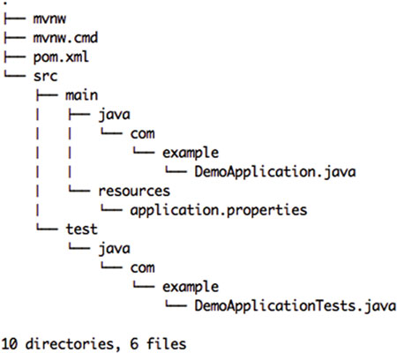
Spring Boot CLI
spring init -d=web,data-jpa -g=com.example -a=demo --package-name=com.example -name=demo
spring [--help] [--version] <command> [<args>]
spring help init
./mvnw spring-boot:run
Notes:
Figure 4-1 shows the demo.zip structure. Take a look at the src folder, which contains the main/java/com/example/DemoApplication.java file and of course its unit test. Also you can see that it contains two additional files, mvnw (for UNIX) and mvnw.cmd (for Windows). These commands allow you to run a Maven project without actually having Maven installed on your system.
You can simply execute the following command: $ ./mvnw spring-boot:run

Slide 38
Using Spring with Spring Boot
If you have already several XML configuration files, you can integrate them with just one annotation in your main application.
The org.springframework.context.annotation.ImportResource annotation accepts an array of string types to add the XML definitions.
@ImportResource({"META-INF/spring/services-context.xml","META-INF/spring/repositoriescontext.xml"})
@SpringBootApplication
Public class SpringXmlApplication {
@Autowired
TaskRepository task;
@Autowired
ServiceFacade service;
//More logic...
}
@ImportResource("classpath:applicationContext.xml")
Notes:
This section shows you how to use existing Spring apps in Spring Boot applications. Remember that Spring Boot is Spring, so this is an easy task, but let’s start by considering the Spring container and the configurations and how you can use them in Spring Boot.
If you have already several XML configuration files, you can integrate them with just one annotation in your main application. The org.springframework.context.annotation.ImportResource annotation accepts an array of string types to add the XML definitions.

Slide 39
Web Development with Spring Boot
spring-web module
has basic web integration features such as multipart file upload functionality,
initialization of the Spring container (by using servlet listeners), and a web-oriented application context.
spring-mvc module (aka, the web server module)
contains all the Spring MVC (Model-View-Controller) and REST services implementations for web applications.
The Spring MVC is designed around the org.springframework.web.servlet.DispatcherServlet class.
Notes:
Let’s start talking about the Spring MVC technology and some of its features. Remember that the Spring Framework consists of about 20 modules or technologies, and the web technology is one of them. For the web technology, the Spring Framework has the spring-web, spring-webmvc , spring-websocket , and spring-webmvc-portlet modules.
With the DispatcherServlet you have out-of-the-box several resolutions strategies, including View resolvers, Locale resolvers, Theme resolvers, and Exception handlers. In other
words, the DispatcherServlet will take a HTTP request and redirect it to the right handler (the class marked with the @Controller and the methods that use the @RequestMapping annotations) and the right view (your JSPs).

Slide 40
Spring MVC auto-configuration
The auto-configuration adds the following features on top of Spring’s defaults:
• Inclusion of ContentNegotiatingViewResolver and BeanNameViewResolver beans.
• Support for serving static resources, including support for WebJars.
• Automatic registration of Converter, GenericConverter, Formatter beans.
• Support for HttpMessageConverters.
• Automatic registration of MessageCodesResolver.
• Static index.html support.
• Custom Favicon support.
• Automatic use of a ConfigurableWebBindingInitializer bean
Notes:
If you want to keep Spring Boot MVC features, and you just want to add additional MVC configuration (interceptors, formatters, view controllers etc.) you can add your own @Configuration
class of type WebMvcConfigurerAdapter, but without @EnableWebMvc.

Slide 41
Web Development with Spring Boot
spring init -d=web,thymeleaf,data-jpa,data-rest -g=com.apress.spring -a=spring-boot-journal --package-name=com.apress.spring -name=spring-boot-journal -x
Notes:
You are going to continue using the Spring Boot Journal application, but with some modifications, so you can see the power of using the Spring MVC with Spring Boot.
These commands will be the initial template for the Spring Boot journal. Now you are getting familiar with the Spring Initializr. In this case you already know that you are going create a web application that will use the Thymeleaf templating engine for the views, the JPA for all the data access, and a new starter, the data-rest , which will allow to expose the data repositories as RESTful API
Did you notice that in Listing, there is no <version> tag in the MySQL dependency? This is because the spring-boot-starter-parent pom has a dependency on the spring-boot-dependencies , where all the versions that work with Spring are declared in this case the MySQL driver library. That’s why working with Spring Boot is so easy—you just add the right starter pom and don’t have to worry about third-party dependencies.
application.properties file
You have two sections. The first section declares the values that the javax.sql. DataSource will use, such as the JDBC URL, the credentials, and testWhileIdle and validationQuery .
These are useful for keeping the connection if it’s been idle for a long time. The second section declares all dependencies related to JPA and Hibernate. The show-sql will log all the SQL (you can turn this on and off). The hibernate.ddl-auto property will create the table (based on your declared entities annotated with @Entity ) and when the app finishes, it will drop it. The other possible values are create and update (the update value is recommended for production environments). hibernate.name-strategy will use the best naming for your tables and fields in your database, and hibernate.dialect is useful for generating the SQL optimized for the database engine—in this case MySQL.

Slide 42
Web Development with Spring Boot
import org.springframework.data.jpa.repository.JpaRepository;
import com.apress.spring.domain.JournalEntry;
public interface JournalRepository extends JpaRepository<JournalEntry, Long> { }
./mvnw spring-boot:run
The HAL (Hypertext Application Language) is a representation of media, such as links.
This is used by the HATEOAS (Hypermedia as the Engine of Application State) as a way to manage REST endpoints through media links.
HATEOAS is a REST service pattern in which navigation links are provided as part of the payload metadata. The client application determines the state and follows the transition URLs provided as part of the state.
Notes:
After you run this command and then open a browser and go to http://localhost:8080 , you will get some kind of message. Most likely an error about opening a type: application/hal+json or a Save File As window because the browser doesn’t know how to handle this particular type of response.
What you are getting from the application is a HAL+JSON response. The HAL (Hypertext Application Language) is a representation of media, such as links. This is used by the HATEOAS (Hypermedia as the Engine of Application State) as a way to manage REST endpoints through media links, but how does the HATEOAS/HAL get here? Well, very simple. Remember that in the pom.xml file there is the spring-bootstarter-data-rest dependency. This dependency will include the JPA models as a way to expose through the HATEOAS media links for your REST API. This journal app is now an operational REST API web application.
Returning to the browser problem—how can you see the result of the application/hal+json format? curl -i http://localhost:8080. If you want to use the browser, I suggest that you use Google Chrome and install the JSONView add-on.
What is HATEOAS?
HATEOAS, which stands for Hypermedia as the Engine of Application State, is a type (concept actually) of REST architecture that enables enhanced decoupling of server and client. The basic idea is that with every response, the server provides a list of endpoints (or "links") to perform actions or retrieve information related to the data in the response.

Slide 43
Web Development with Spring Boot
You can post a value to the REST API. Just execute the following command in a terminal window:
curl.exe -d "@data.json" -H "Content-Type: application/json" -X POST http://localhost:8080/journalEntries
Yes! You have the GET, POST, PUT, PATCH, and DELETE HTTP methods, which you can run against the
http://localhost:8080/journalEntries URL.
Notes:
curl -i http://localhost:8080/journalEntries/1
{
"title": "CloudFoundry",
"summary": "Learn about Cloud Foundry and push a Spring Boot Application",
"created": "12-11-2017"
}

Slide 44
Web Development with Spring Boot
What about searching?
public interface JournalRepository extends JpaRepository<JournalEntry, Long> {
List<JournalEntry> findByCreatedAfter(@Param("after") @DateTimeFormat(iso =ISO.DATE) Date date);
List<JournalEntry> findByCreatedBetween(@Param("after") @DateTimeFormat(iso =ISO.DATE) Date after,@Param("before") @DateTimeFormat(iso = ISO.DATE) Date before);
List<JournalEntry> findByTitleContaining(@Param("word") String word);
List<JournalEntry> findBySummaryContaining(@Param("word") String word);
}
Notes:
Listing 8-7 shows you the new version of the JournalRepository.java interface. There are four query methods with parameters marked by the @Param and @DateTimeFormat annotations. @Param has a value that will define the parameter name to use for the URL. @DateTimeFormat is a helper for that parameter when thetype is the date value, meaning that you will need to pass a date in the form of yyyy-mm-dd, which is the ISO date format.
curl.exe -i http://localhost:8080/journalEntries/search/findByTitleContaining?word=Cloud
curl.exe -i http://localhost:8080/journalEntries/search/findByCreatedAfter?after=2016-02-01

Slide 45
Web Development with Spring Boot
What about searching?
"_links" : {
"self" : {
"href" : "http://localhost:8080/journalEntries"
},
"profile" : {
"href" : "http://localhost:8080/profile/journalEntries"
},
"search" : {
"href" : "http://localhost:8080/journalEntries/search"
}
},
curl -i http://localhost:8080/journalEntries/search/findByTitleContaining?word=Cloud
Notes:
Now you can run your application:
$ ./mvnw spring-boot:run
And execute the following command in a different terminal window:
$ curl -i http://localhost:8080/journalEntries
When you execute this command, you will see at the end of the response a new URL in the _links section: You can query that URL with cURL or the browser:
After you added the methods, they were converted into an endpoint-that is, into RESTful API! So, by using the findByTitleContaining method, you can execute the
following command:

Slide 46
Web Development with Spring Boot
Playing with the HAL Browser
<dependency>
<groupId>org.springframework.data</groupId>
<artifactId>spring-data-rest-hal-browser</artifactId>
</dependency>
The HAL browser is a handy API browser for hal+json data.
Notes:
One of the newest features of spring-data-rest and the web components is that you can install a HAL browser that works out of the box.
<dependency>
<groupId>org.springframework.data</groupId>
<artifactId>spring-data-rest-hal-browser</artifactId>
</dependency>
If you rerun your application, go to the http://localhost:8080/api/browser . You will see something similar to Figure .
Figure 8-5 shows you the HAL browser, which is a very nice tool to inspect your REST API. Add /api/journal to the Explorer field and click the Go button.

Slide 47
Testing with Spring Boot
By default, the spring-boot-starter-test pom includes the Spring integration test for Spring applications, the JUnit, which is the de facto standard for unit testing Java applications, AssertJ, Hamcrest (a library of matcher objects), and Mockito (the Java mocking framework).
import org.junit.Test;
import org.junit.runner.RunWith;
import org.springframework.boot.test.context.SpringBootTest;
import org.springframework.test.context.junit4.SpringRunner
@RunWith(SpringRunner.class)
@SpringBootTest
public class SprintBootApplicationTests {
@Test
public void contextLoads() {
}
}
Notes:
By default, the Spring Initializr includes a test class, as shown in Listing
@RunWith(Springunner.class) . The @RunWith annotation belongs to the JUnit library and it will invoke the class it’s referencing ( SpringRunner.class ) to run the tests instead of the runner built into JUnit. The SpringRunner class is a custom extension of the JUnit’s BlockJUnit4ClassRunner . It provides all the functionality of the Spring Test Context Framework.
@SpringApplicationConfiguration(classes = SprintBootApplication.class). This is a class-level annotation that knows how to load and configure an ApplicationContext , which means that you can have direct access to all the Spring container classes by just using the @Autowired annotation. In this case, the main SpringBootApplication class wires everything up.
@Test . This is a JUnit test annotation that will execute the method when the tests start. You can have one or more methods. If you have several methods with this annotation, it won’t execute them in order. For that you need to add the @FixMethodOrder(MethodSorters.NAME_ASCENDING) annotation to the class.
Spring Boot provides a @SpringBootTest annotation which can be used as an alternative to the standard spring-test @ContextConfiguration annotation when you need Spring Boot features. The annotation works by creating the ApplicationContext used in your tests via SpringApplication.

Slide 48
Testing with Spring Boot
@RunWith(SpringJUnit4ClassRunner.class)
@SpringApplicationConfiguration(classes = SprintBootWebApplication.class)
@WebAppConfiguration
public class SpringBootWebApplicationTests {
@Test
public void contextLoads() {
}
}
Notes:
@WebAppConfiguration . It’s a class-level annotation that loads the org.springframework.web.context.WebApplicationContext implementation, which will ensure that all your files and beans related to the web app are accessible.
Let’ss create an example application (simple-web-spring-boot) that you can use for testing. Once it’s running you can go to http://localhost:8080/journal/all and http://localhost:8080/journal/findBy/title/cloud
Before I talk about the unit test, you are going to use a library that is useful to test JSON objects. It’s called JsonPath by the company Jayway.
https://github.com/json-path/JsonPath

Slide 49
Testing with Spring Boot
private HttpMessageConverter mappingJackson2HttpMessageConverter;
private MediaType contentType = new MediaType(MediaType.APPLICATION_JSON.getType(),
MediaType.APPLICATION_JSON.getSubtype(),
Charset.forName("utf8"));
private MockMvc mockMvc;
@Autowired
private WebApplicationContext webApplicationContext;
Notes:
HttpMessageConverter<T> is an interface that helps to convert from and to HTTP requests and responses. You are going to use it to create a JSON format to post when you test.
The MediaType instance specifies that the actual call will be a JSON object. The MockMvc is a helper class provided by the Spring MVC test module
The WebApplicationContext will provide the configuration for a web application and it will be necessary to create the MockMvc instance.
toJsonString(Object) . This is a helper method that will write the actual journal entry to a JSON object.
https://docs.spring.io/spring-framework/docs/current/spring-framework-reference/html/integration-testing.html#spring-mvc-test-framework

Slide 50
Testing with Spring Boot
There is another project that makes testing REST endpoint easier
https://github.com/jayway/rest-assured.
The name of the library is Rest-Assured and it provides a fluent API to test RESTful APIs.

Slide 51
Working with Spring Data Repositories
The central interface in Spring Data repository abstraction is Repository
The CrudRepository provides sophisticated CRUD functionality for the entity class that is being managed.
public interface CrudRepository<T, ID extends Serializable> extends Repository<T, ID> {
<S extends T> S save(S entity);
Optional<T> findOne(ID primaryKey);
Iterable<T> findAll();
Long count();
void delete(T entity);
boolean exists(ID primaryKey);
}
Notes:
The goal of Spring Data repository abstraction is to significantly reduce the amount of boilerplate code required to implement data access layers for various persistence stores.
Repository interface acts primarily as a marker interface to capture the types to work with and to help you to discover interfaces that extend this one. The CrudRepository provides sophisticated CRUD functionality for the entity class that is being managed.
Saves the given entity.
Returns the entity identified by the given id.
Returns all entities.
Returns the number of entities.
Deletes the given entity.
Indicates whether an entity with the given id exists.

Slide 52
Working with Spring Data Repositories
public interface PagingAndSortingRepository<T, ID extends Serializable> extends CrudRepository<T, ID> {
Iterable<T> findAll(Sort sort);
Page<T> findAll(Pageable pageable);
}
PagingAndSortingRepository<User, Long> repository = // … get access to a bean
Page<User> users = repository.findAll(new PageRequest(1, 20));
Spring provides persistence technology-specific abstractions like e.g. JpaRepository or MongoRepository.
Notes:
These interfaces extend CrudRepository and expose the capabilities of the underlying persistence technology in addition to the rather generic persistence technology-agnostic interfaces like e.g. CrudRepository.
On top of the CrudRepository there is a PagingAndSortingRepository abstraction that adds additional methods to ease paginated access to entities:

Slide 53
Working with Spring Data Repositories
Defining repository interfaces
As a first step you define a domain class-specific repository interface.
Selectively exposing CRUD methods
@NoRepositoryBean
interface MyBaseRepository<T, ID extends Serializable> extends Repository<T, ID> {
T findOne(ID id);
T save(T entity);
}
interface UserRepository extends MyBaseRepository<User, Long> {
User findByEmailAddress(EmailAddress emailAddress);
}
Notes:
First step: The interface must extend Repository and be typed to the domain class and an ID type. If you want to expose CRUD methods for that domain type, extend CrudRepository instead of Repository.
In this first step you defined a common base interface for all your domain repositories and exposed findOne(…) as well as save(…).These methods will be routed into the base repository implementation of the store of your choice provided by Spring Data ,e.g. in the case if JPA SimpleJpaRepository, because they are matching the method signatures in CrudRepository.
Note, that the intermediate repository interface is annotated with @NoRepositoryBean. Make sure you add that annotation to all repository interfaces that Spring Data should not create instances for at runtime.

Slide 54
Working with Spring Data Repositories
Defining query methods
The repository proxy has two ways to derive a store-specific query from the method name.
It can derive the query from the method name directly, or by using a manually defined query. Available options depend on the actual store.
However, there’s got to be a strategy that decides what actual query is created.
http://docs.spring.io/spring-data/jpa/docs/current/reference/html/#repositories.core-concepts
This class is a Dynamic Proxy, generated by Spring using the JDK Reflection API

Slide 55
Data Access with Spring Boot
Data Access Using the JDBC Template with Spring Boot
Data Access Using JPA with Spring Boot
NoSQL Databases
classification system for these emergent NoSQL databases.
• Column (Cassandra, HBase, etc.)
• Document (CouchDB, MongoDB, etc.)
• Key-Value (Redis, Riak, etc.)
• Graph (Neo4J, Virtuoso, etc.)
• Multi-Model (OrientDB, ArangoDB, etc.)
Notes:
You had to download the correct drivers and connection strings, open and close connections, SQL statements, result sets, and transactions, and convert from result sets to objects. In my opinion, these are all very manual tasks. Then a lot of ORM (Object Relational Mapping) frameworks started to emerge to manage these tasks—frameworks like Castor XML, Object-Store, and Hibernate to mention a few. They allowed you to identify the domain classes and create XML that was related to the database’s tables. At some point you also needed to be an expert to manage those kind of frameworks.
The Spring Framework helped a lot with those frameworks by following the template design pattern.
For JDBC: jdbc:h2:mem:testdb .
Mongo:
show dbs;
Again, because you are using the spring-data and spring-data-mongodb abstractions, you can have query methods. In this example it will find a title that contains a word. The query method findByTitleLike will be translated to MongoDB query syntax. Something like db.journal.find({"title": /.*?1*/}) or similar.

Slide 56
Messaging with Spring Boot
Messaging can be synchronous and asynchronous, pub-sub and peer-to-peer, RPC and enterprise-based, Message Broker, ESB (Enterprise Service Bus), MOM (Message Oriented Middleware), etc.
JMS with Spring Boot
Notes:
JmsTemplate . The JmsTemplate instance is a helper class that simplifies asynchronous JMS access code. This template uses the DynamicDestinationResolver and SimpleMessageConverter classes as default strategies for resolving a destination name (queue names) or converting a message.
sendTo(queue, message) . This method has two parameters—the name of queue (destination) and the message, both as type String . This method uses then jmsTemplate to use the convertAndSend method call to send the message and pass the name of the queue and the actual message. The convertAndSend method will try to use the best available message converter, and by default it will use the SimpleMessageConverter class. The SimpleMessageConverter will identify if the message is a String , Map , byte[] array, or Serializable object.
If you run your application several times, you will notice that the Consumer prints out its message before the Producer . When Spring Boot starts doing the auto-configuration and properly wiring the beans, the messageListener bean is part of that wiring, so it automatically starts to listen to the Queue for messages. Remember that the Producer is declared in the sendMessage method. This method happens last because it returns the CommandLineRunner interface. That筑s why you see the Consumer print out before the Producer .
http://localhost:8161/admin – for ActiveMQ

Slide 57
Messaging with Spring Boot
RabbitMQ with Spring Boot
RabbitMQ implements the AMQP protocol (Advance Message Queuing Protocol )
RabbitMQ/AMQP: Exchanges, Bindings, and Queues
AMQP defines exchanges , which are entities where the messages are sent. Every exchange takes a message and routes it to a zero or more queues . This routing involves an algorithm that is based on the exchange type and some rules, called bindings .
Notes:
RabbitMQ is written in Erlang, so its major dependency is to install the Erlang runtime in your system. Nowadays all the RabbitMQ installers come with all the Erlang dependencies
The AMQP defines three concepts that are a little different from the JMS world, but very easy to understand.

Slide 58
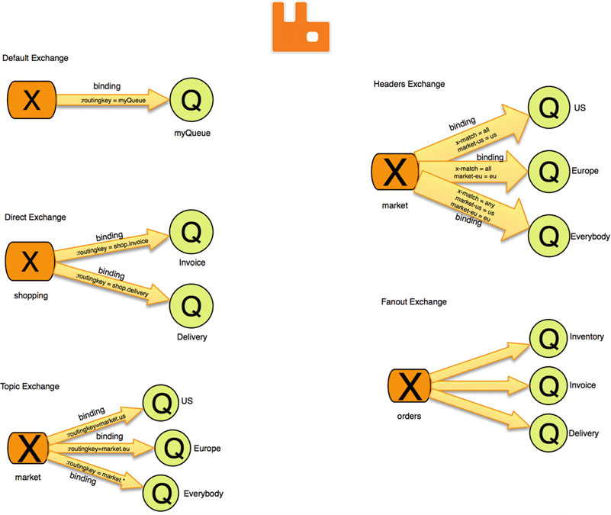
Messaging with Spring Boot
Notes:
The AMQP defines three concepts that are a little different from the JMS world, but very easy to understand (exchange, routes, binding). Every exchange takes a message
and routes it to a zero or more queues . This routing involves an algorithm that is based on the exchange type and some rules, called bindings .
The main idea is to send a message to an exchange including a routing key, then the exchange based on its type will deliver the message to the queue (or it won’ if the routing key doesn’t match).
The default exchange will be bound automatically to every queue created. The direct exchange is bound to a queue by a routing key; you can see this exchange type as one-to-one binding. The topic exchange is similar to the Direct Exchange; the only difference is that in its binding you can add a wildcard into its routing key. The headers exchange is similar to the topic exchange; the only difference is that the binding is based on the message headers (this is a very powerful exchange, and you can do all and any expressions for its headers). The fanout exchange will copy the message to all the bound queues; you can see this exchange as a message broadcast.
The example in this section will use the default exchange type, which means that the routing key will be equal to the name of the queue. Every time you create a queue, RabbitMQ will create a binding from the default exchange (that the actual name is just an empty string) to the queue using the queue’s name.
rabbitmq-plugins enable rabbitmq_management
http://localhost:15672 (guest:guest )

Slide 59
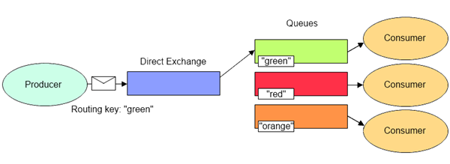
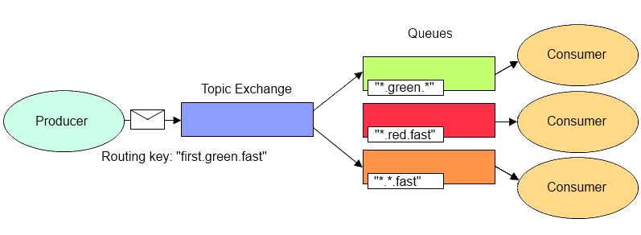
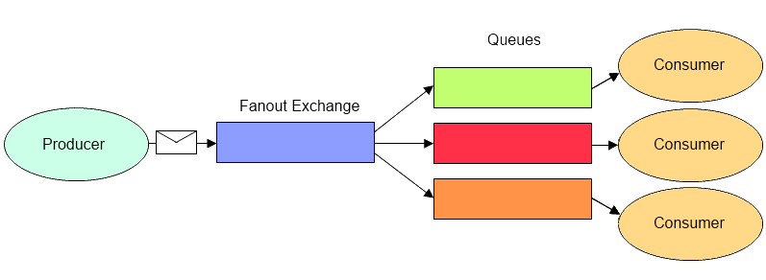
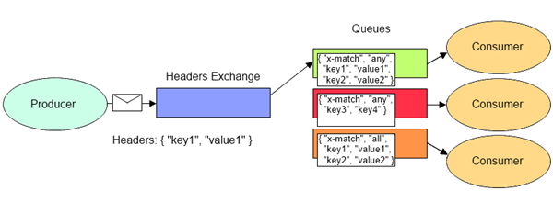
Messaging with Spring Boot
Notes:
The Topic exchange type routes messages to queues whose routing key matches all, or a portion of a routing key. With topic exchanges, messages are published with routing keys containing a series of words separated by a dot (e.g. “word1.word2.word3”).
The headers exchange type is similar to the topic exchange type in that more than one criteria can be specified as a filter, but the headers exchange differs in that its criteria is expressed in the message headers as opposed to the routing key,

Slide 60
Messaging with Spring Boot
To connect to a remote RabbitMQ,the application.properties file:
spring.rabbitmq.host=mydomain.com
spring.rabbitmq.username=rabbituser
spring.rabbitmq.password=thisissecured
spring.rabbitmq.port=5672
spring.rabbitmq.virtual-host=/production
Notes:
http://localhost:15672
If you want to access a remote RabbitMQ, you add the following properties to the application.properties file:
spring.rabbitmq.host=mydomain.com
spring.rabbitmq.username=rabbituser
spring.rabbitmq.password=thisissecured
spring.rabbitmq.port=5672
spring.rabbitmq.virtual-host=/production

Slide 61
Security with Spring Boot
Enable simple security
Security Using the application.properties File
In-Memory Security
Security Using a Database
Notes:
Spring security is centered around AuthenticationProvider and specialized UserDetailsService ; it also provides integration with identity provider systems, such as LDAP, Active Directory, Kerberos, PAM, AOuth, and so on. By default, the AuthenticationManager interface implementation has a single username, called user . When the Spring Boot app starts, the autoconfiguration
Will identify that you have the web and the security dependencies and it will create the basic security authentication.
@EnableGlobalAuthentication . This annotation marks the class and configures all the necessary beans to activate the security on the application; it signals that the annotated class can be used to configure a global instance of the AuthenticationManagerBuilder . AuthenticationManagerBuilder allows you to easily build your authentication by adding UserDetailsService and the authentication providers.
schema.sql , which contains the mandatory account table for the security. This table is mandatory and is an adaptation from the Spring Security documents:
https://docs.spring.io/spring-security/site/docs/current/reference/html/appendix-schema.html .

Slide 62
Security with Spring Boot
Securing Resources
Spring Boot with OAuth2
Notes:
WebSecurityConfigurerAdapter . There are different ways to configure the resources of your web application and extending from the abstract WebSecurityConfigurerAdapter
class is one of them. One of the common patterns is to override the configure(HttpSecurity) and configure(AuthenticationManagerBuilder) methods, but because you have the init(AuthenticationManagerBuilder) method overridden from the GlobalAuthenticationConfigurerAdapter of the JdbcSecurityConfiguration class, it’s not necessary to do it here. That’s why the only method you need to override is the one with the HttpSecurity instance as a parameter.
HttpSecurity class has a fluent API (a builder), so it already has an integrated login form!
sec:authorized . This attribute is part of the Thymeleaf library and it will execute the isAuthenticated() method. This method is a global method of the main web security, so this attribute knows how to access the global security and execute the method. If the current user is authenticated, it will show a small form that contains the post to the /logout endpoint.
SecurityContext context = SecurityContextHolder.getContext();
Authentication authentication = context.getAuthentication();
The base root object is SecurityExpressionRoot, and it defines common security terms and predicates available for use in both web and method security contexts.

Slide 63
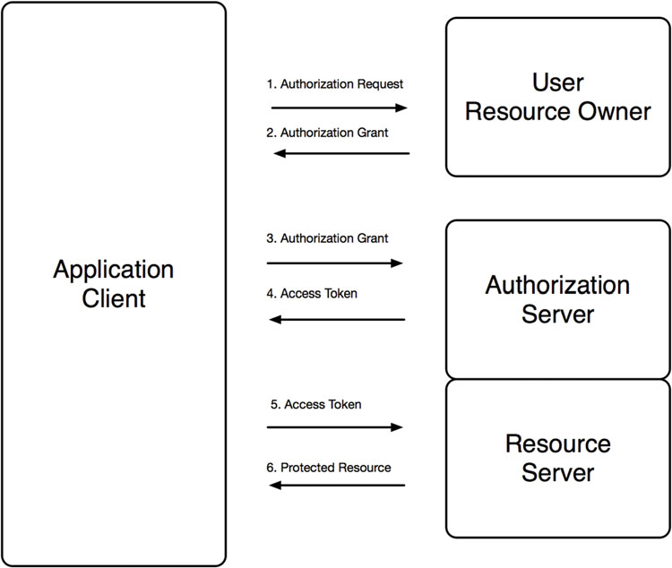
Security with Spring Boot
Spring Boot with OAuth2
There is a guide that talks about Spring Boot and OAuth2 that uses AngularJS as a client, and I recommend you read it:
https://spring.io/guides/tutorials/spring-bootoauth2/
.
Notes:
OAuth It specifies a process for resource owners to authorize third-party access to their server resources without sharing their credentials.. Oauth essentially allows access tokens to be issued to third-party clients by an authorization server, with the approval of the resource owner.
@EnableAuthorizationServer . This annotation enables the authorization /oauth/authorize and the token /oauth/token endpoints. The user is responsible for securing the authorization endpoint. The token endpoint will be automatically secured using HTTP basic authentication on the client’s credentials.—in this case by using the username and password from the database.
@EnableResourceServer . This annotation enables the Spring security filter that authenticates requests via an incoming OAuth2 token.
ResourceServerConfigurerAdapter . The ResourceOAuthSecurityConfiguration class extends this class ResourceServerConfigurerAdapter , which is just a interface marker because it implements the ResourceServerConfigurer interface, allowing the program to override the configure(ResourceServerSecurityConfigurer) and configure(HttpSecurity) methods. In this case the class is overriding configure(HttpSecurity) to add security to some resources.

Slide 64
Spring Boot Actuator
actuator
autoconfig
beans
configprops
docs
dump
e n v
flyway
health
info
Notes:
Spring Boot includes an Actuator module , which introduces production-ready non-functional requirements to your application. What makes the Actuator module more attractive is that you can expose data through different technologies, like HTTP (endpoints), JMX, and SSH.
The Actuator gives you all the possible endpoints that you can access. The /actuator endpoint will provide a hypermedia-based discovery page for all the other endpoints,
but it will require the Spring HATEOAS in the classpath, so if you include this in your pom.xml :
<dependency>
<groupId>org.springframework.hateoas</groupId>
<artifactId>spring-hateoas</artifactId>
</dependency>
/env: This endpoint will expose all the properties from the Spring’s ConfigurableEnvironment interface. This will show any active profiles and system environment variables and all application properties, including the Spring Boot properties.
Flyway: This endpoint will provide all the information about your database migration scripts; it’s based on the Flyway project ( https://flywaydb.org/ ). This is very useful when you want to have full control of your database by versioning your schemas.
/info
This endpoint will display the public application info. This means that you need to add this information to application.properties .

Slide 65
Spring Boot Actuator
logfile
metrics
mappings
shutdown
trace
Notes:
metrics : This endpoint shows the metrics information of the current application, where you can determine the how much memory it’s using, how much memory is free, the uptime of your application, the size of the heap is being used, the number of threads used, and so on.
One of the important features about this endpoint is that it has some counters and gauges that you can use. CounterService. CounterService is a service interface that can be used to increment, decrement, and reset a named counter value.
Mappings: This endpoint shows all the lists of all @RequestMapping paths declared in your application.
shutdown : This endpoint is not enabled by default. It allows the application to be gracefully shut down. This endpoint is sensitive, which means it can be used with security, and it should be. (The only endpoints that are not sensitive are /docs , /info and /health .)
trace : This endpoint shows the trace information, which is normally the last few HTTP requests.

Slide 66
Spring Boot Actuator
Sensitive Endpoints
https://docs.spring.io/springboot/docs/current/reference/html/production-ready-endpoints.html
Changing the Endpoint ID
endpoints. beans .id=spring
Changing the Management Endpoints Path
management.port=-1
Notes:
I mentioned that the /shutdown is a sensitive endpoint, meaning that if you add security to your pom.xml it will be secured by default. The only endpoints that are not sensitive are /docs , /info and /health . So, if you want to disable the sensitive feature, you can configure them in the application.properties file. For example, imagine that you already have security and you don,t want to be prompted for the username and password for the /beans and /trace endpoints. What you need to do is add the following to your application.properties file:
endpoints. beans .sensitive=false
endpoints. trace .sensitive=false
you don’t like the /beans endpoint, at the end this is referring to the Spring beans, so what about if you change this endpoint to /spring .
endpoints. beans .id=spring
You can also disable security, change the address, or change the port for the endpoints:
management.context-path=/monitor
management.security.enabled=false
management.port=8090
management.address=127.0.0.1

